Slide 1
FIT1045 Introduction to Algorithms and Programming Lecture 4 Loops and Repetition
COMMONWEALTH OF AUSTRALIA
Copyright Regulations 1969
WARNING
This material has been reproduced and communicated to you by or on behalf of Monash University pursuant to Part VB of the Copyright Act 1968 (the Act).The material in this communication may be subject to copyright under the Act.Any further reproduction or communication of this material by you may be the subject of copyright protection under the Act.
Do not remove this notice.

Slide 2
Objectives
To introduce simple approaches to implement repetition in python.

Slide 3
Overview
For loops
While loops
Infinite loops
Nested loops

Slide 4
Simple loop
Must end expression with :
Starts at 0
>>> for k in range(10):
print(str(k))
0
1
2
3
4
5
6
7
8
9
Must indent code (at least 4 spaces)
Ends at 9

Slide 5
Squares
k starts at 0
>>> for k in range(10):
print(str(k*k))
0
1
4
9
16
25
36
49
64
81
k ends at 9

Slide 6
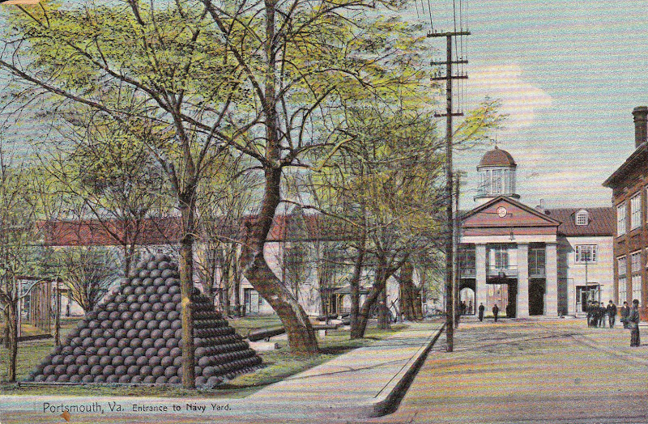
How many cannonballs are there in the pile?
http://www.nnsyhistorymatters.com/2015/02/the-cannonball-pile-at-trophy-park.html

Slide 7
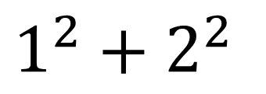
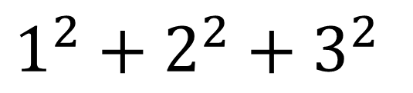
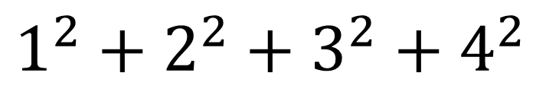

Square Pyramidal Numbers
$$1$$
$$1^{2}+2^{2}$$
$$1^{2}+2^{2}+3^{2}$$
$$1^{2}+2^{2}+3^{2}+4^{2}$$

Slide 8
pyramidal.py
'Print the nth Pyramidal number'
n = int(input("Which Pyramidal number do you want? "))
count = 0
for k in range(n):
count = count + k*k
print("The " + str(n) + " Pyramidal number is " + str(count))
Note there is no indent

Slide 9
Other simple loops
>>> for k in range(5, 10):
print(str(k))
5
6
7
8
9
>>> for k in range(10, -6, -2):
print(str(k))
10
8
6
4
2
0
-2
-4

Slide 10
How many numbers are printed by the following code? for k in range(2, 10): print(str(k))
7
8
9
None of the above
30

Slide 11
Recall
>>> s = “HELLO”
H
E
L
L
O
s
index
0
1
2
3
4
>>> for k in range(5):
print(s[k])
H
E
L
L
O

Slide 12
Alternative
>>> s = “HELLO”
>>> for char in s:
print(char)
H
E
L
L
O

Slide 13
Logic of an while statement
Boolean
expression
true
false
block

Slide 14
while statement
Must end expression with :
while boolean_expression:
block
Boolean
expression
true
false
block
Must indent code (at least 4 spaces)

Slide 15
Sequence of integers
>>> for k in range(10):
print(str(k))
>>> k = 0
>>> while k < 10:
print(str(k))
k = k + 1

Slide 16
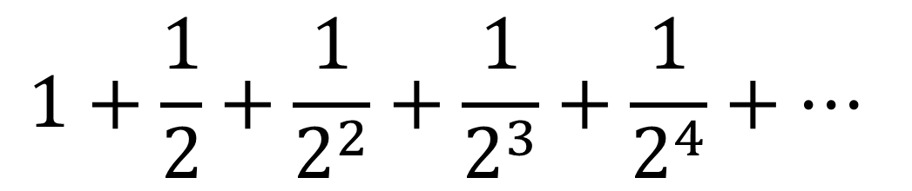
Geometric Series
$$1+\frac{1}{2}+\frac{1}{2^{2}}+\frac{1}{2^{3}}+\frac{1}{2^{4}}+⋯$$
>>> 1 + 1/2
1.5
>>> 1 + 1/2 + 1/(2**2)
1.75
>>> 1 + 1/2 + 1/(2**2) + 1/(2**3)
1.875
>>> approx = 0
>>> term = 1
>>> n = 0
>>> while term > 1e-10:
approx = approx + term
n = n + 1
term = 1/(2**n)
>>> approx
1.9999999998835847

Slide 17
Geometric Series
>>> approx = 0
>>> term = 1
>>> while term > 1e-10:
approx = approx + term
term = term/2
>>> approx
1.9999999998835847
The same
The same
>>> approx = 0
>>> term = 1
>>> while term > 1e-10:
approx += term
term /= 2
>>> approx
1.9999999998835847

Slide 18
Infinite loops
name = 'Don Quixote’
while True:
guess = input("Enter guess: ")
if name == guess:
print("Correct")
break

Slide 19
How many times is the value of count printed in the following code? count = 0 while count <= 25: print(str(count)) count = count - 1
24
25
26
None of the above
30

Slide 20
Simple cipher
a -> T
b -> H
c -> E
d -> Q
e -> U
f -> I
g -> C
h -> K
i -> B
j -> R
k -> O
l -> W
m -> N
n -> F
o -> X
p -> J
q -> M
r -> P
s -> S
t -> V
u -> L
v -> A
w -> Z
x -> Y
y -> D
z -> G
Suppose we have the message:
take the rubicon
Then we would encode it as:
VTOU VKU PLHBEXF

Slide 21
encode.py
plain = 'abcdefghijklmnopqrstuvwxyz'
cipher = 'THEQUICKBROWNFXJMPSVLAZYDG'
message = input("Enter message: ")
for char in message:
if char in plain:
position = plain.find(char)
print(cipher[position], end = '')
else:
print(char, end='')

Slide 22
encode.py (better version)
plain = 'abcdefghijklmnopqrstuvwxyz'
cipher = 'THEQUICKBROWNFXJMPSVLAZYDG'
message = input("Enter message: ")
'Change message to lower case'
message = message.lower()
for char in message:
if char in plain:
position = plain.find(char)
print(cipher[position], end = '')
else:
print(char, end='')

Slide 23
decode.py
plain = 'abcdefghijklmnopqrstuvwxyz'
cipher = 'THEQUICKBROWNFXJMPSVLAZYDG'
message = input("Enter message: ")
'Change message to upper case'
message = message.upper()
for char in message:
if char in cipher:
position = cipher.find(char)
print(plain[position], end = '')
else:
print(char, end='')
upper instead lower
plain and cipher swapped

Slide 24
Reading Text Files
name = input("Enter input file name: ")
infile = open(name)
for line in infile:
'Change line to lower case'
line = line.lower()
print(line)
infile.close()

Slide 25
How many times is j*k printed in the following code? for j in range(10): for k in range(10, 2, -1): print(str(j*k))
100
90
80
None of the above
30

Slide 26
Writing Text Files
name = input("Enter input file name: ")
infile = open(name)
name = input("Enter output file name: ")
outfile = open(name, 'w')
for line in infile:
'Change line to lower case'
line = line.lower()
outfile.write(line)
infile.close()
outfile.close()

Slide 27
Encoding Files
plain = 'abcdefghijklmnopqrstuvwxyz'
cipher = 'THEQUICKBROWNFXJMPSVLAZYDG'
name = input("Enter input file name: ")
infile = open(name)
name = input("Enter output file name: ")
outfile = open(name, 'w')
for line in infile:
'Change line to lower case'
line = line.lower()
for char in line:
if char in plain:
position = plain.find(char)
outfile.write(cipher[position])
else:
outfile.write(char)
infile.close()
outfile.close()

Slide 28
Recommended reading
“Introduction to Computing using Python: An Application Development Focus”, by L. Perkovic
Sections 2.3 and 5.3
“Introduction to the design and analysis of algorithms”
Chapter 1

